Slide 1
Final Year Project On
Twitter Sentiment Analysis
Dept. Of Computer Science and Engineering, NIT Jalandhar
Mentor:
Dr. Rajneesh Rani
Co-Mentors:
Ms. Amandeep Kaur
Ms. Kirti Bhandari
Presented By(Group 20):
Sunil Kumar(13103034)
Bhiman Baghel(13103043)
Manoj Meena(13103042)
Sanjeet(13103019)

Slide 2
Presentation Outline
Project Aim
Project Motivation
Flow Chart
Tweet Gathering
Tweet Pre processing and cleaning
Feature extraction
Sentiment Analysis
Front end
Results
Accuracy
Future improvements
References

Slide 3
Project Aim
To implement an algorithm for automatic classification of text into positive, negative or neutral.
Sentiment Analysis to determine the attitude of the mass is positive, negative or neutral towards the subject of interest.
Graphical representation of sentiment in the form of pie-chart.
Sentiment analysis of Persons, Movies, Mobiles and Places.

Slide 4
Project Motivation
Twitter is a popular micro blogging service where users create status messages (called “tweets”). These tweets sometimes express opinions about different topics. Using this analyser,
Consumers can use sentiment analysis to research products or services before making a purchase. E.g. Mobiles
Marketers can use this to research public opinion of their company and products, or to analyse customer satisfaction. E.g. Election Polls
Organizations can also use this to gather critical feedback about problems in newly released products. E.g. Brand Management (Nike, Adidas)

Slide 5





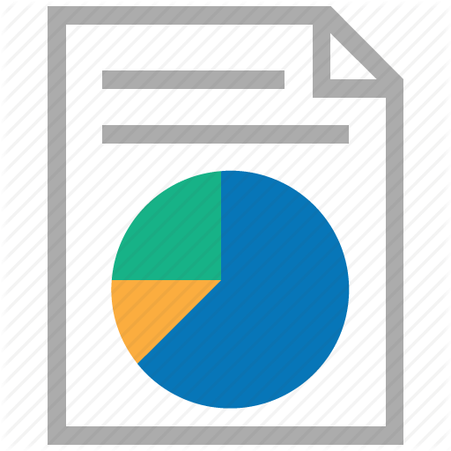
Flow chart
See Existing Analysis Or Put New Search
See Existing Analysis
Connect to Twitter API
Select A category
Pre -Processing and Cleaning
Retrieve Comments
Feature Extraction
Sentiment Analysis
Display Analysis
Display Results

Slide 6
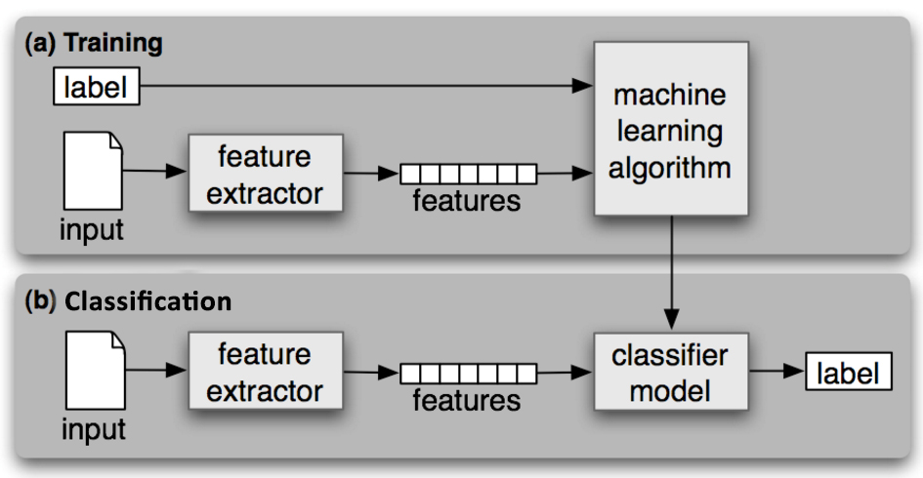
Training and classification

Slide 7
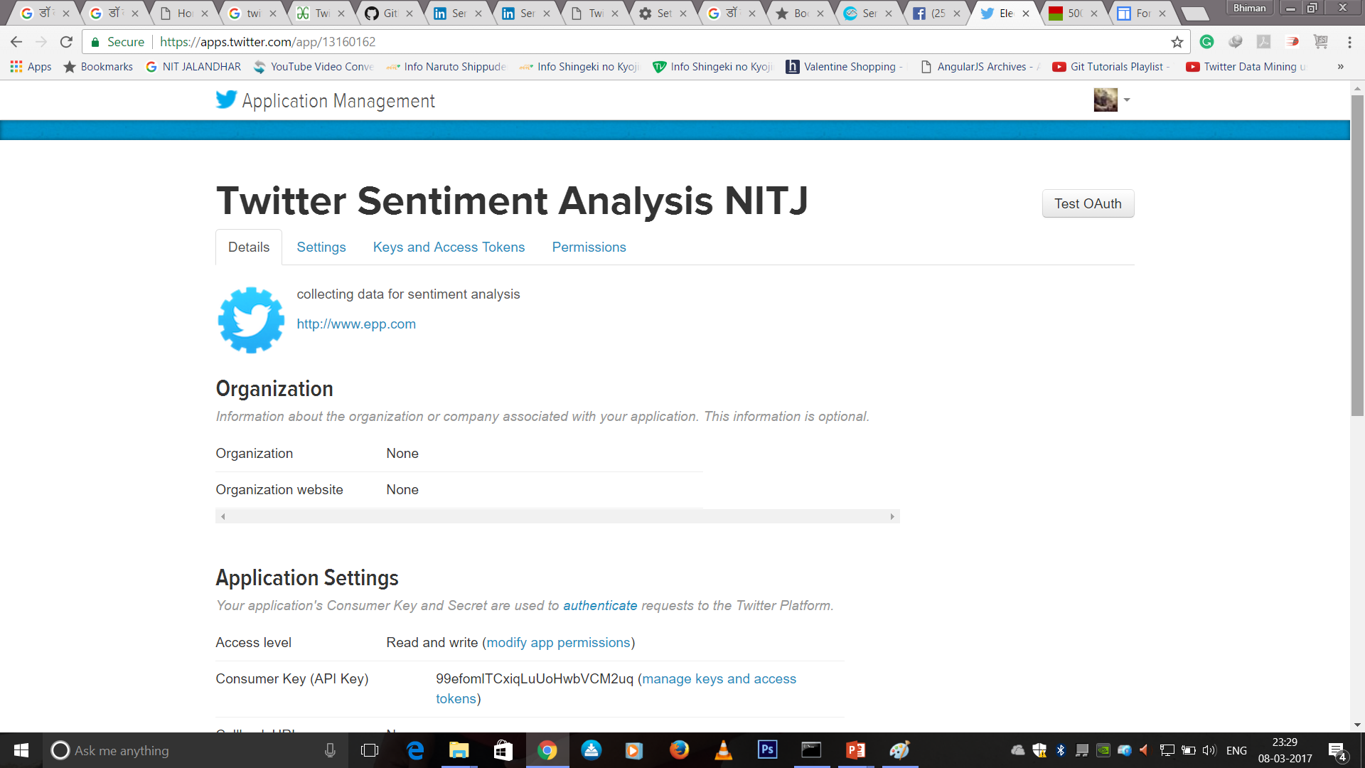
Tweet Gathering
SITE : dev.twitter.com/apps

Slide 8
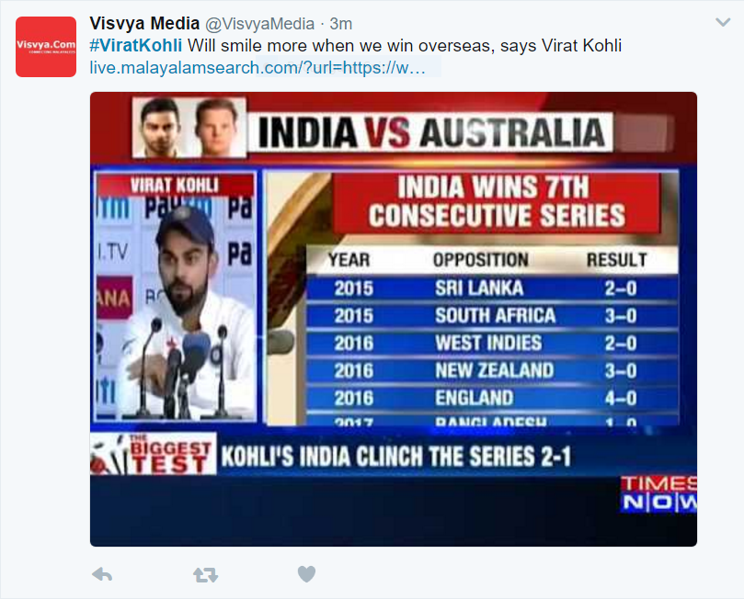
Tweet Gathering (output)
{"created_at":"Sat Mar 11 18:12:24 +0000 2017","id":840626474596028416,"id_str":"840626474596028416","text":"#ViratKohli Will smile more when we win overseas, says Virat Kohli http://live.malayalamsearch.com/?url=https://www.youtube.com/watch?v=MnpDmJ5YTQM …","source":"\u003ca href=\"http:\/\/twitter.com\/download\/android\" rel=\"nofollow\"\u003eTwitter for Android\u003c\/a\u003e","truncated":false,"in_reply_to_status_id":null,"in_reply_to_status_id_str":null,"in_reply_to_user_id":null,"in_reply_to_user_id_str":null,"in_reply_to_screen_name":null,"user":{"id":707258468328034304,"id_str":"707258468328034304","name":"Santhosh RAJ BJP","screen_name":"SanthoshRAJBJP","location":null,"url":null,"description":null,"protected":false,"verified":false,"followers_count":67,"friends_count":255,"listed_count":0,"favourites_count":408,"statuses_count":443,"created_at":"Tue Mar 08 17:35:33 +0000 2016","utc_offset":null,"time_zone":null,"geo_enabled":false,"lang":"en","contributors_enabled":false,"is_translator":false,"profile_background_color":"F5F8FA","profile_background_image_url":"","profile_background_image_url_https":"","profile_background_tile":false,"profile_link_color":"1DA1F2","profile_sidebar_border_color":"C0DEED","profile_sidebar_fill_color":"DDEEF6","profile_text_color":"333333","profile_use_background_image":true,"profile_image_url":"http:\/\/pbs.twimg.com\/profile_images\/796725628489768960\/xfDJg202_normal.jpg","profile_image_url_https":"https:\/\/pbs.twimg.com\/profile_images\/796725628489768960\/xfDJg202_normal.jpg","default_profile":true,"default_profile_image":false,"following":null,"follow_request_sent":null,"notifications":null},"geo":null,"coordinates":null,"place":null,"contributors":null,"is_quote_status":false,"retweet_count":0,"favorite_count":0,"entities":{"hashtags":[],"urls":[],"user_mentions":[],"symbols":[]},"favorited":false,"retweeted":false,"filter_level":"low","lang":"en","timestamp_ms":"1489255944285"}

Slide 9

Tweet Pre-processing & Cleaning
Hashtag
URL
"#ViratKohli Will smile more when we win overseas, says Virat Kohli http://live.malayalamsearch.com/?url=https://www.youtube.com/watch?v=MnpDmJ5YTQM …“
"#viratkohli will smile more when we win overseas, says virat kohli http://live.malayalamsearch.com/?url=https://www.youtube.com/watch?v=mnpdmj5ytqm …“
#viratkohli -> viratkohli -> By using regular Expression
http://live.malayalamsearch.com/?url=https://www.youtube.com/watch?v=mnpdmj5ytqm … -> url -> By regular Expression
"viratkohli will smile more when we win overseas says virat kohli url“ -> cleaned tweet

Slide 10
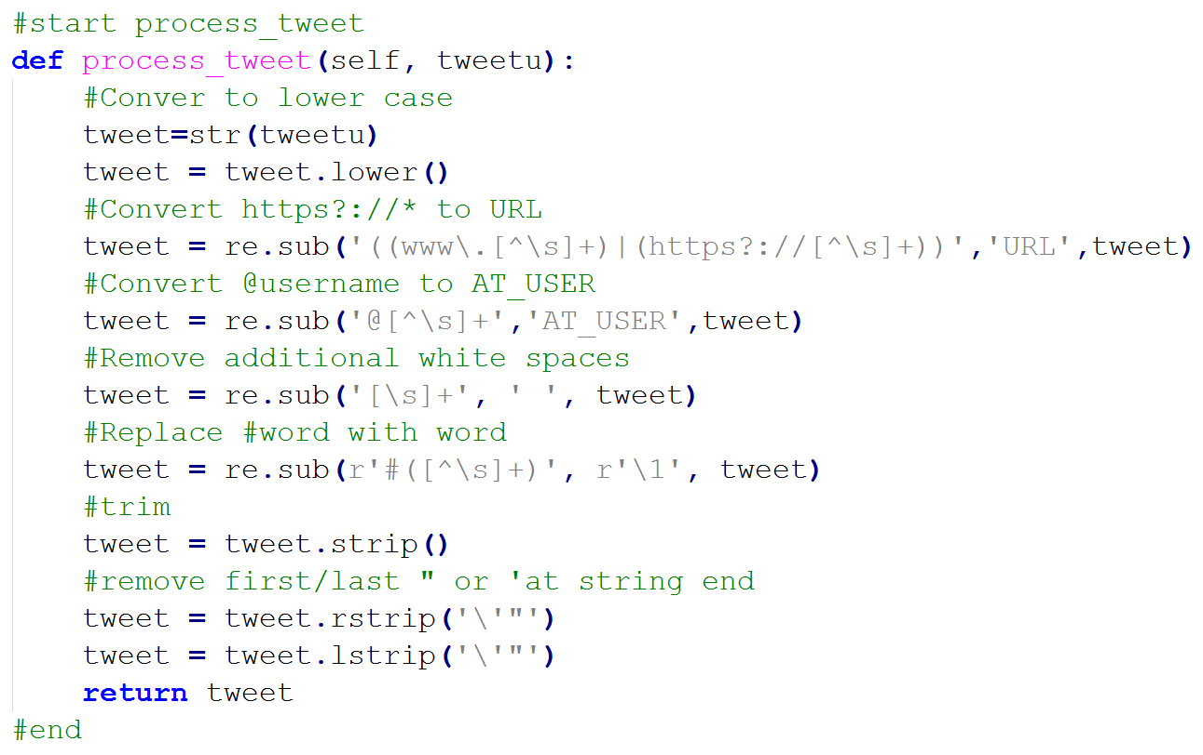
Tweet Pre-processing & Cleaning(CODE)

Slide 11
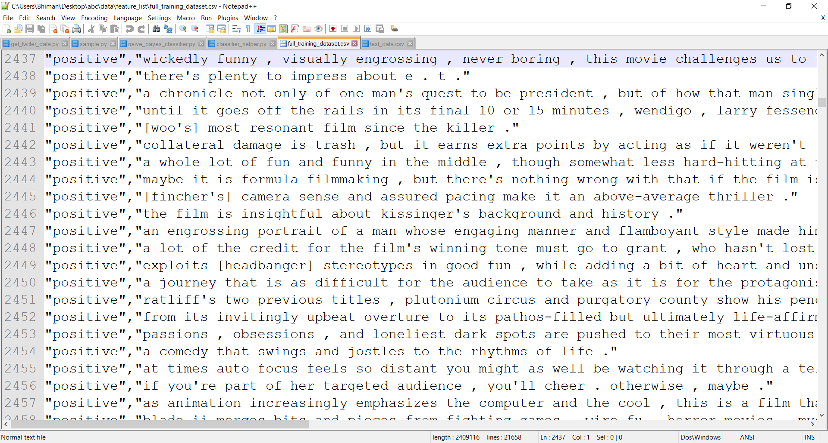
Feature Extraction(Training Data)

Slide 12
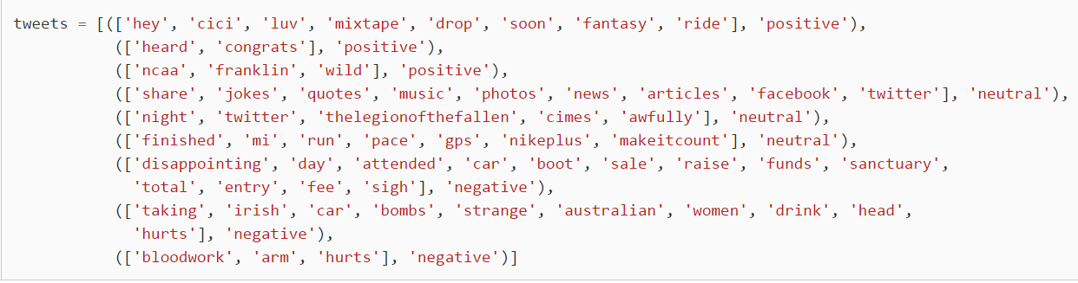
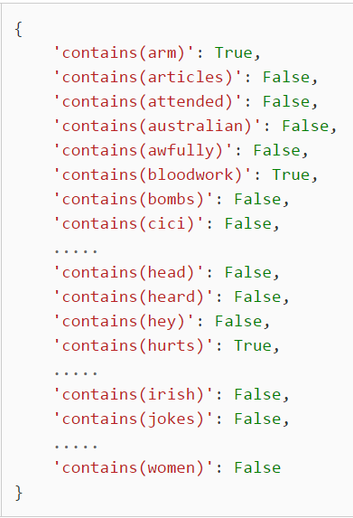
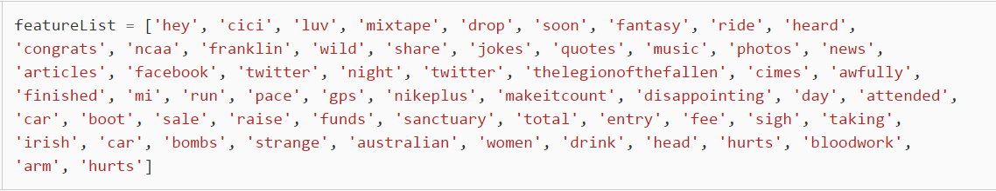
Feature Extraction

Slide 13
Sentiment Analysis
Calculate the probability of occurrence of each word in the tweet with respect to positive, negative and neutral.
Classify the tweet as either positive, negative or neutral on the basis of these probabilities.
Then count the no. of positive, negative and neutral tweets about that topic.
Then we plot the pie chart using matplotlib(python library).

Slide 14
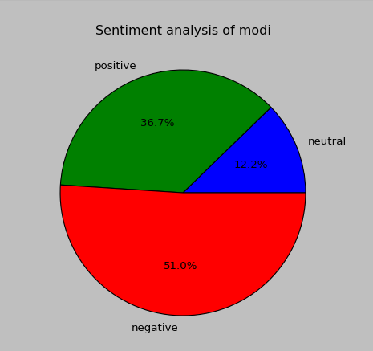
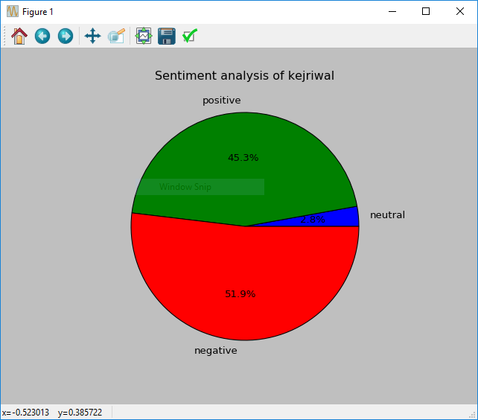
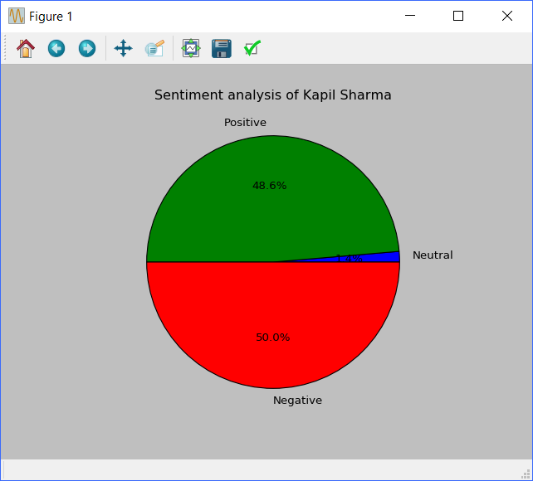
OUTPUT
Positive
Negative
Neutral

Slide 15
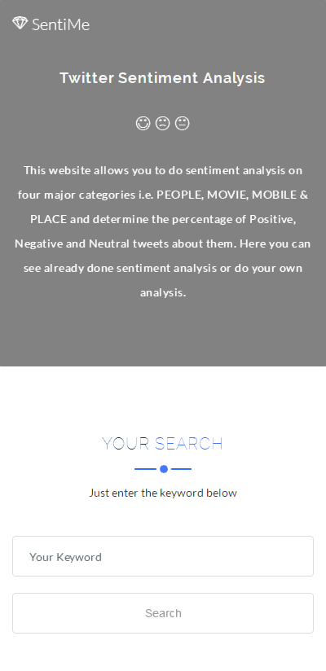
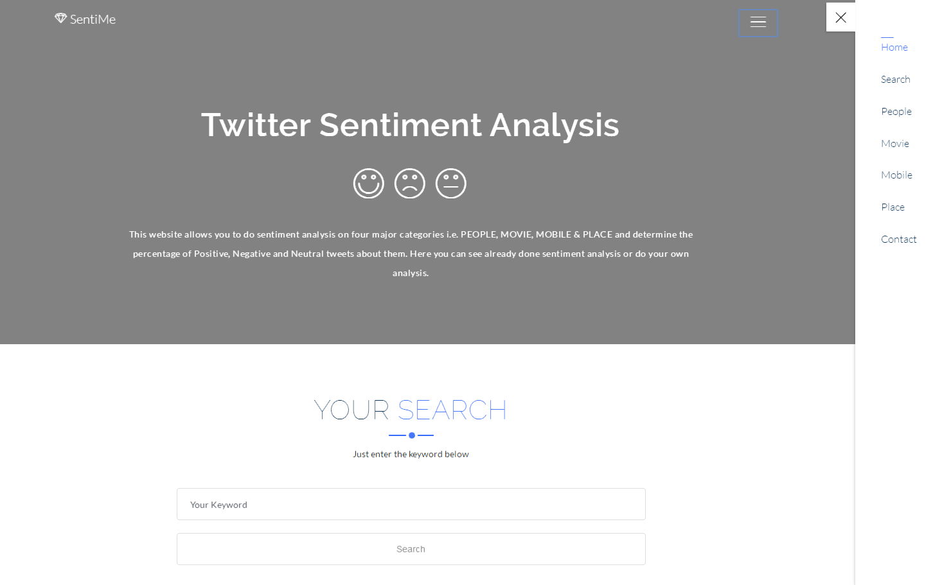
FRONT END
Desktop View
Mobile View

Slide 16
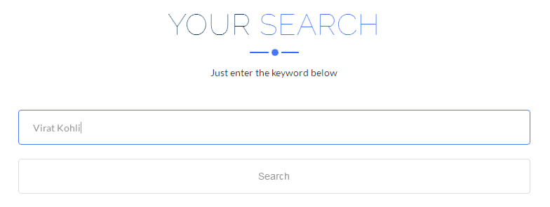
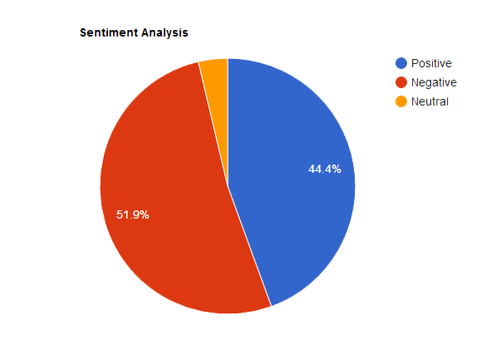
SEARCH SECTION: User can insert a keyword and see the sentiment analysis about it

Slide 17
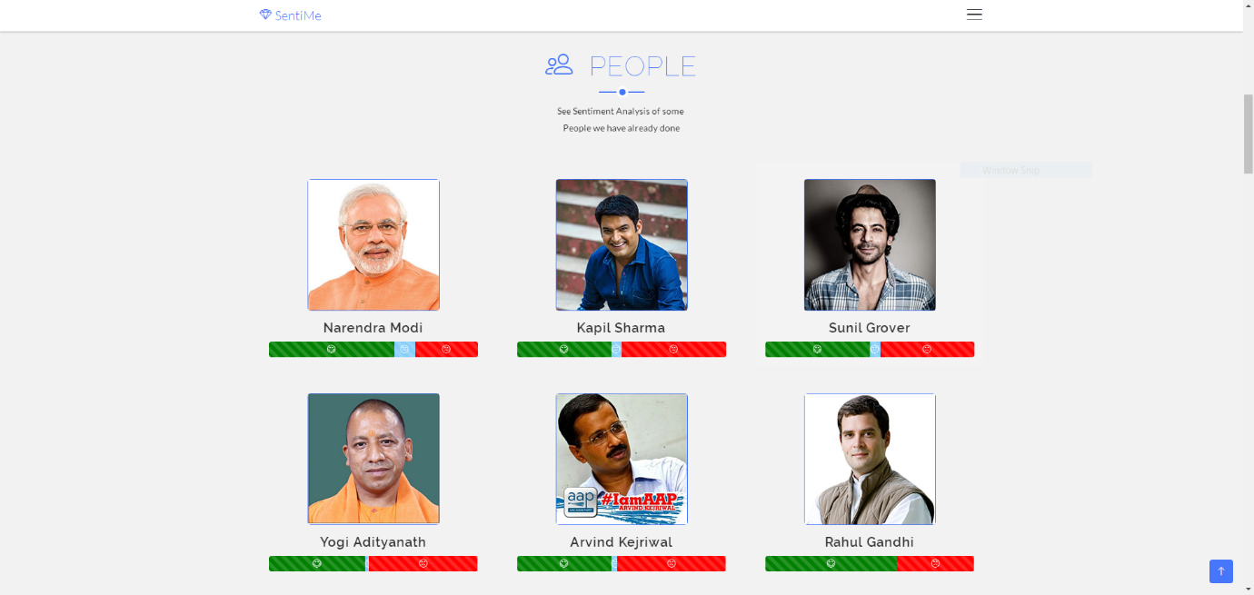
PEOPLE SECTION: User can see pre existing sentiment analysis of some people

Slide 18
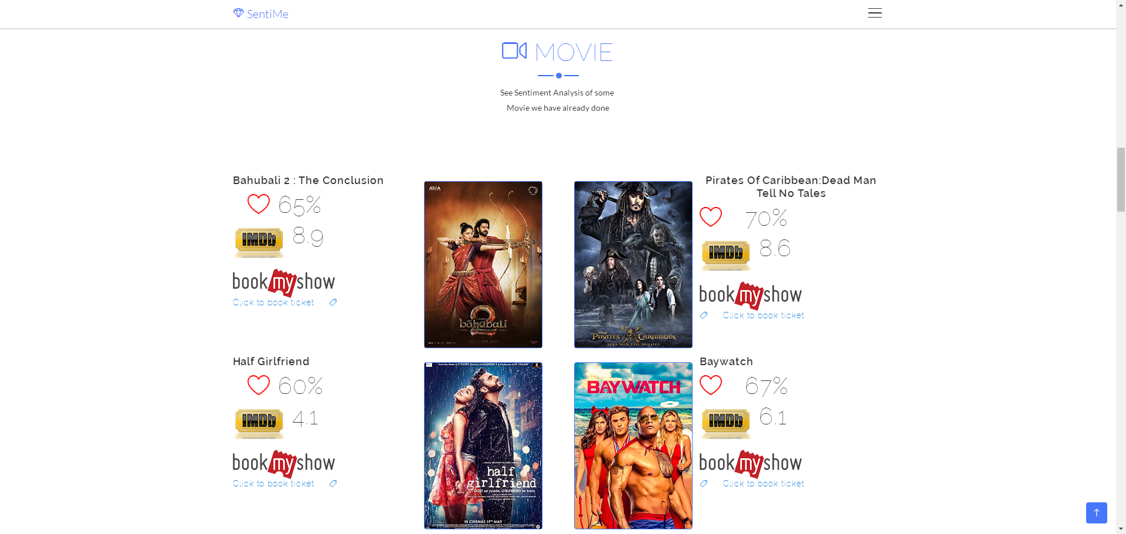
MOVIE SECTION: User can see pre existing sentiment analysis of some movies with their IMDB ratings and a link to BookMyShow

Slide 19
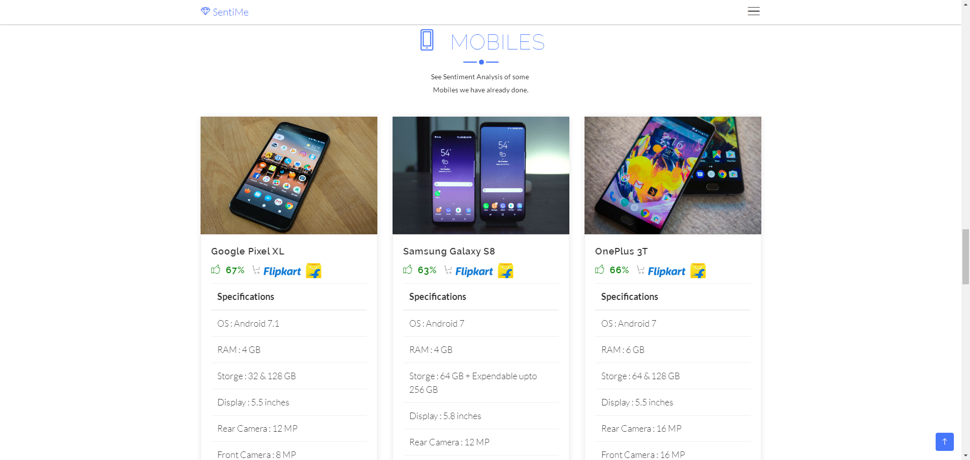
MOBILES SECTION: User can see pre existing sentiment analysis of some mobiles with their specifications and a link to Flipkart

Slide 20
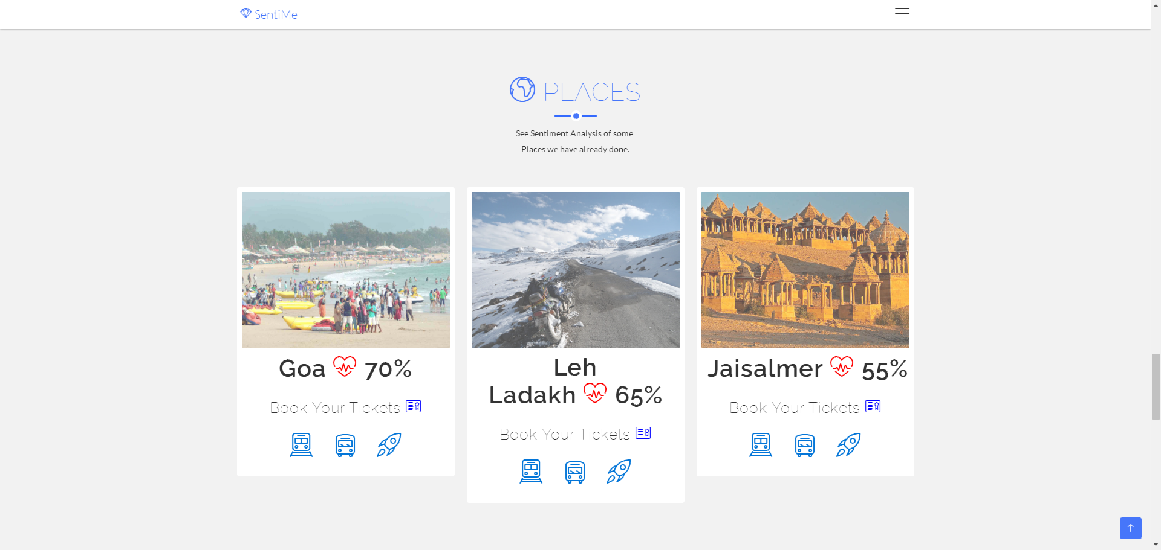
PLACES SECTION: User can see pre existing sentiment analysis of some places and links to RedBus and IRCTC

Slide 21





FRONT END & BACK END TECHNOLOGIES USED
Django Framework and Twitter Bootstrap framework
Languages used : Python, HTML, CSS, JavaScript
SQLite database

Slide 22
Accuracy
Data consist of 8521 tweets in which 3125 are classified as positive, 3125 as negative and 2271 as neutral
Data |  | Accuracy
Testing data | Training Data | Naive Bayes | Maximum Entropy
20% | 80% | 77.04% | 53.7%
30% | 70% | 77.08% | 54.01%
40% | 60% | 78.15% | 54.25%

Slide 23
FUTURE IMPROVEMENTS
Use Bigram approach to improve the accuracy.
Add more categories like brands, government policies etc.
Add long term sentiment analysis line graph.
The training dataset in the order of millions will cover a better range of twitter words and hence better unigram feature vector resulting in an overall improved model. This would vastly improve upon the existing classifier results.
In this project, the focus is only on English tweets but Twitter has a huge international audience. It should be possible to use the approach followed in the project to classify sentiment in other languages with a language specific positive/negative keyword list.

Slide 24
References
Alec Go, Richa Bhayani, Lei Huang, “Twitter Sentiment Classification using Distant Supervision” in Technical report, Stanford Digital Library Technologies Project, 2009,
B. Pang and L. Lee, “Opinion mining and sentiment analysis Foundations and Trends in Information Retrieval”, 2008
G. Mishne, Workshop on “Stylistic Analysis Of Text For Information Access”, 2005
For training data set –www.sentiment140.com
Python Natural Language Toolkit - http://www.nltk.org/
Python 3 Documentation - https://docs.python.org/3/
Django Documentation 1.11 - https://docs.djangoproject.com/en/1.11/
Practical Machine Learning Tutorial - https://pythonprogramming.net/machine-learning-tutorial-python-introduction/
Bootstrap framework - http://getbootstrap.com/
Introduction to Matplotlib Tutorial - https://pythonprogramming.net/matplotlib-intro-tutorial/

Slide 25
Thank You

